Slide 1
IBM University Engagement Project Submission
“Exploring the Power of Agentic AI with IBM Granite and LangFlow”

Slide 2

Project Title – CareerSathi AI
AI-Powered Career Guidance and Skill Development Assistant
Domain of Project – Education
Student Name | Recent Passport Photo | Email ID | Mobile number [WhatsApp]
Betha eswara sri lakshmi meghana |  | buelab85@gmail.com | 9121849788

Slide 3
Problem Statement - AI Career Counselor Rural Youth
The Challenge:
Many rural students face difficulties in choosing the right career path due to limited access to professional career guidance, lack of awareness about emerging opportunities, and scattered information about skills, courses, and job requirements.
As a result, students often struggle to make informed decisions about their education, skill development, and future careers.
The Objective:
Our Solution – CareerSathi AI
CareerSathi AI is an AI-powered career guidance assistant that provides personalized career recommendations, skill-development roadmaps, learning resources, and placement preparation guidance.
The platform helps students:
► Explore suitable career paths
► Identify required skills and learning resources
► Build personalized career roadmaps
► Receive placement and interview guidance
► Access reliable career information anytime
Impact
CareerSathi AI empowers rural youth with accessible, personalized, and real-time career guidance, helping them transform career aspirations into actionable plans.

Slide 4
Technology Used
Tech Stack
Core Technologies
IBM watsonx Orchestrate – Agent creation, management, and deployment
IBM watsonx.ai – AI platform for model access and inference
IBM Granite Models – Natural language understanding and career guidance generation
IBM Knowledge Base – Stores and retrieves career knowledge for accurate responses
Supporting Technologies
Vercel – Web hosting and deployment
HTML – Frontend structure
JavaScript – Agent embedding and interaction
Knowledge Base / RAG – Career information retrieval and recommendations
IBM watsonx Orchestrate + IBM watsonx.ai + IBM Granite Models + Vercel

Slide 5







Proposed Solution -
CareerSathi AI is an AI-powered Career Counseling Agent built to empower rural and underserved students with personalized career guidance. It acts as a virtual career mentor that understands a student's interests, strengths, academic background, and career goals to recommend suitable career paths, skills to learn, and opportunities to explore.
Built using IBM watsonx Orchestrate, IBM watsonx.ai, Granite Models, and LangFlow, the solution combines intelligent conversation, knowledge retrieval, and multi-agent orchestration to deliver accurate, personalized, and actionable career guidance.
Key Agents & Capabilities
Career Discovery Agent Skill Gap Agent Learning Roadmap Agent Placement Support
Identifies suitable career paths Analyzes current skills Creates personalized Provides interview
based on student interests, against industry demands learning roadmaps with preparation, resume
strengths, personality, and and identifies skill gaps courses, resources building tips, and job
aspirations. with improvement tips. certifications, and projects. search strategies.
Key Features
Usage
• Natural language conversation in English & regional languages • Scholarship & higher education guidance
• Personalized career recommendations • Internship & job opportunity suggestions
• Skill assessment & gap analysis • Real-time doubt resolution
• Step-by-step learning roadmaps • Progress tracking & goal management
• Course & certification recommendations
• Resume & interview preparation support
Students interact via chat interface → share their skills interests, skills, education background → receive personalized career options
→follow learning roadmap →
build skills → get placement & higher education guidance.

Slide 6
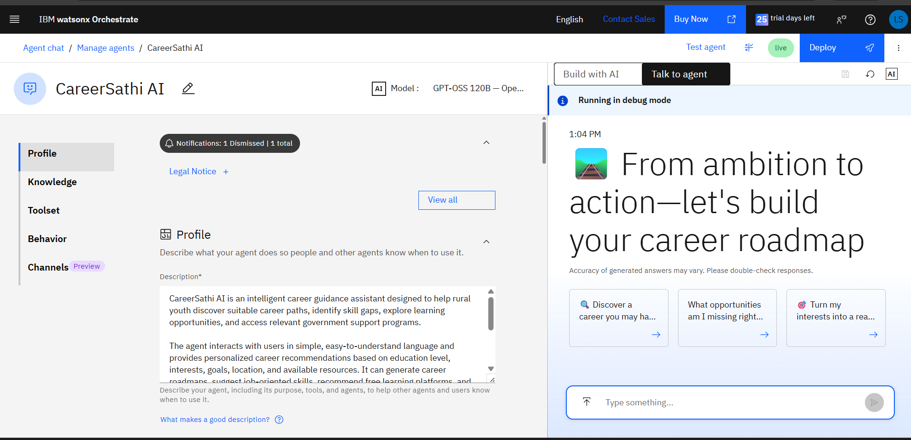
CareerSathi AI

Slide 7
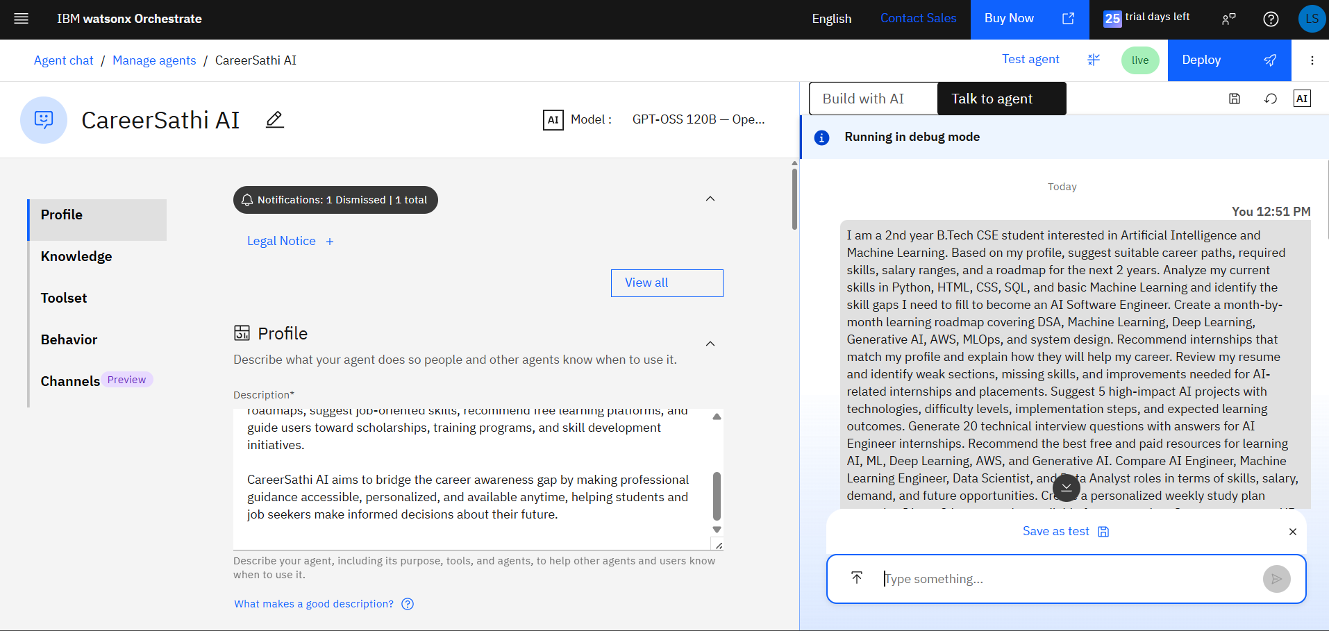
User Query Processing and ResponseTesting

Slide 8
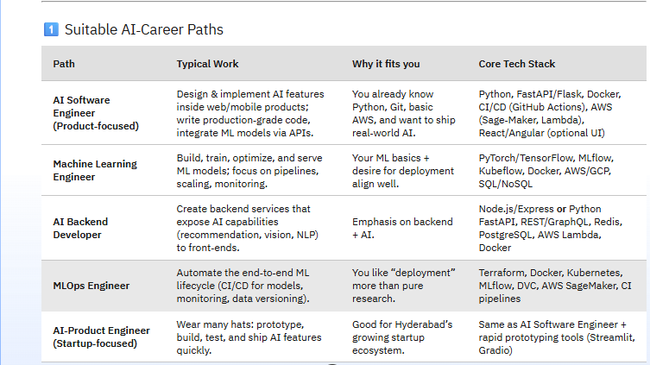
Generated Responses

Slide 9
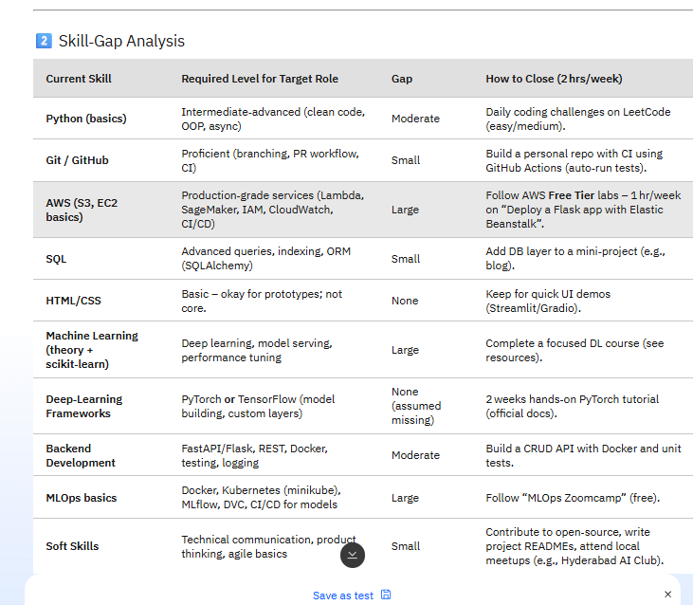

Slide 10
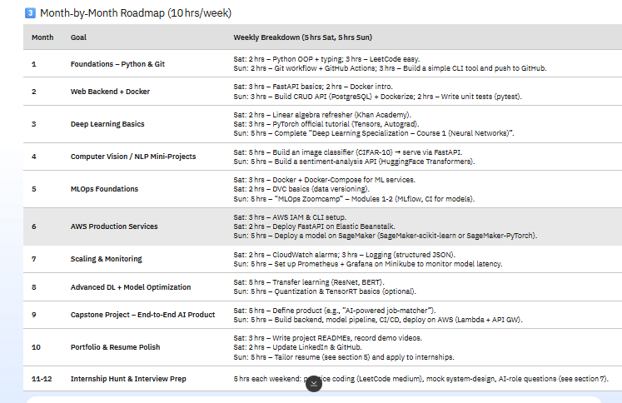

Slide 11
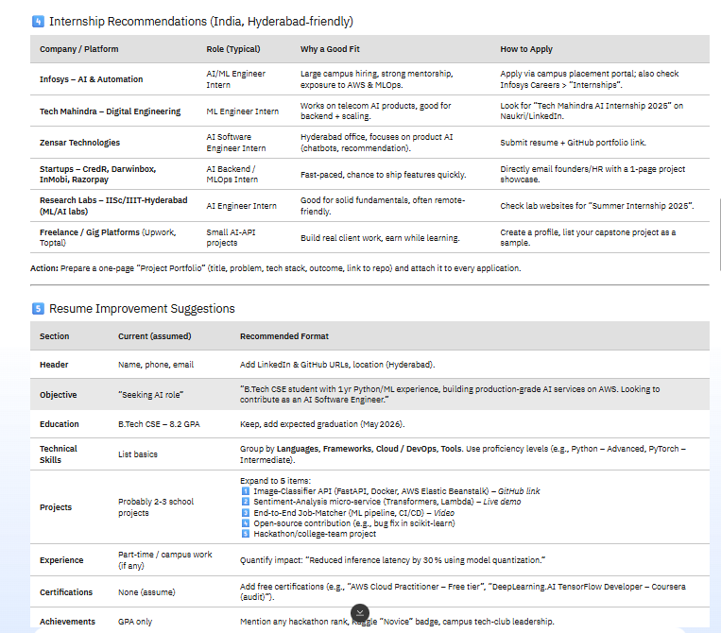

Slide 12
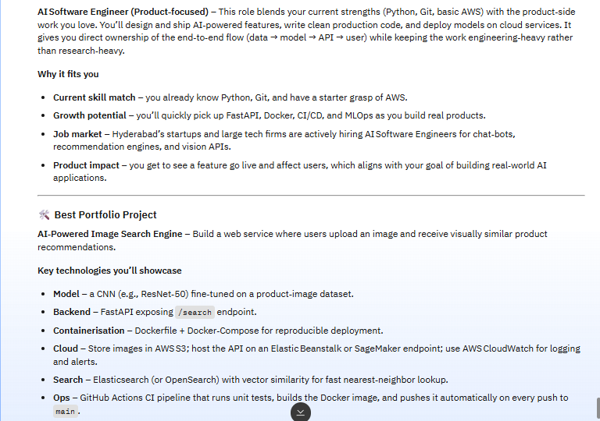

Slide 13
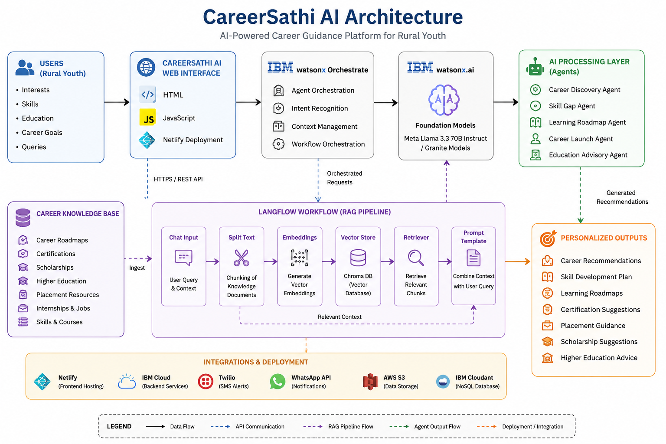

Slide 14

Role of Agentic AI in the solution
Role of Agentic AI in CareerSathi AI
Agentic AI enables CareerSathi AI to function as an intelligent, autonomous career guidance system rather than a simple chatbot. Using IBM watsonx.ai, IBM watsonx Orchestrate, and Granite Models, it coordinates multiple specialized agents to deliver personalized career recommendations.
Each agent performs a specific role—such as career discovery, skill gap analysis, learning roadmap generation, placement support, and higher education guidance—while working collaboratively. This multi-agent approach ensures accurate and context-aware career assistance.
Agentic AI understands a student's interests, educational background, skills, and career goals to provide tailored recommendations. It supports real-time adaptation, continuously refining guidance based on user inputs and changing career aspirations.
Additionally, agents communicate with each other, enabling better decision-making and end-to-end career planning. Overall, Agentic AI makes CareerSathi AI proactive, personalized, and goal-driven, acting like a 24/7 digital career mentor that helps students make informed career decisions and achieve their professional goals.

Slide 15
Technology Used
• IBM watsonx Orchestrate – For orchestrating AI agents, managing conversations, and coordinating career guidance workflows.
• IBM watsonx.ai – For deploying foundation models and generating personalized career recommendations and learning roadmaps.
• IBM Granite Models / Llama Models – For natural language understanding, reasoning, career counseling, and personalized guidance.
• Knowledge Base (KB) – Stores career paths, certifications, scholarships, placement resources, and higher education information for accurate recommendations.
• RAG (Retrieval-Augmented Generation) – Retrieves relevant career information from the Knowledge Base before generating responses, improving accuracy and reliability.
• Vector Database (Chroma DB) – Stores and retrieves career knowledge efficiently for RAG-based recommendations.
• HTML, CSS & JavaScript – Used to build the CareerSathi AI web interface.
• Vercel – Used for deploying and hosting the CareerSathi AI website.

Slide 16
Novelty and Uniqueness
The proposed CareerSathi AI stands out by combining Agentic AI, RAG, Knowledge-Based Guidance, and Personalized Career Planning into a single intelligent career mentoring platform.
Multi-Agent Intelligence – Multiple specialized agents collaborate to provide career discovery, skill gap analysis, roadmap generation, placement support, and higher education guidance.
RAG-Based Accuracy – Retrieves career information from a curated Knowledge Base before generating responses, ensuring reliable and up-to-date recommendations.
Personalized Career Roadmaps – Generates customized learning paths based on a student's interests, skills, academic background, and career goals.
Rural Youth Empowerment – Bridges the career guidance gap for students in rural and underserved areas by providing 24/7 access to expert career mentorship.
Skill Gap Identification – Analyzes current skills and recommends targeted learning resources, certifications, and projects to improve employability.
Career-to-Action Guidance – Goes beyond suggestions by providing step-by-step roadmaps, practical learning plans, and actionable career milestones.
Higher Education & Scholarship Support – Recommends suitable degrees, certifications, scholarships, and higher education opportunities.
Placement Readiness Assistance – Provides interview preparation, resume guidance, and job-oriented learning recommendations.
Scalable & Enterprise-Ready – Built using IBM watsonx Orchestrate, IBM watsonx.ai, Granite Models, LangFlow, and RAG architecture, ensuring reliability, scalability, and AI governance.
Impact: CareerSathi AI acts as a smart digital career mentor, helping students make informed career decisions, build relevant skills, and confidently achieve their professional goals.

Slide 17
Git Hub Link
Github Link:
https://github.com/Meghanabetha17/ibminternship_project
Careersathi_ai Link:
https://careersathiai.vercel.app/
·
·
·

Slide 18
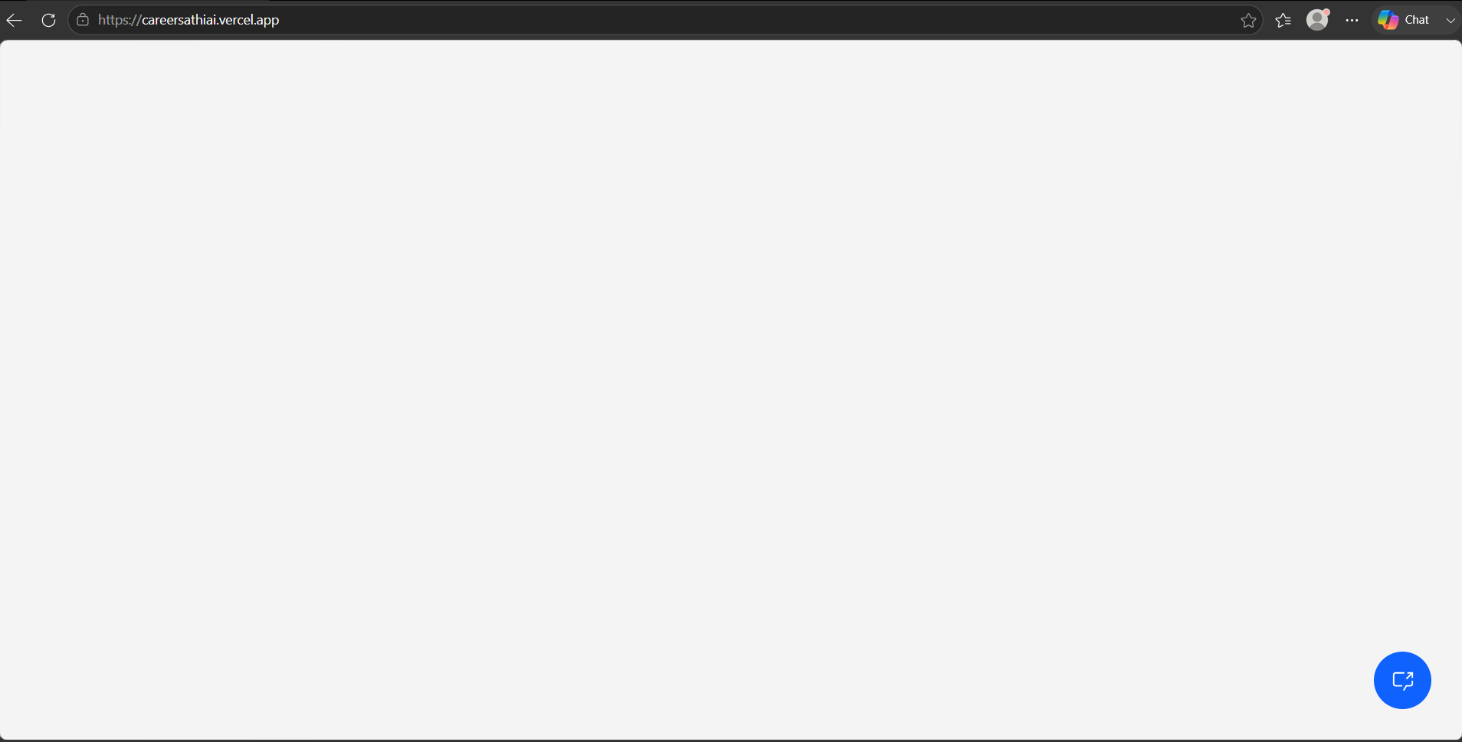
How to Access CareerSathi AI
Step 1: Click the CareerSathi AI link. CareerSathi AI / https://careersathiai.vercel.app/
Step 2: The CareerSathi AI webpage will open.
Step 3: Click the chat toggle button located at the bottom-right corner of the page.
Click here

Slide 19
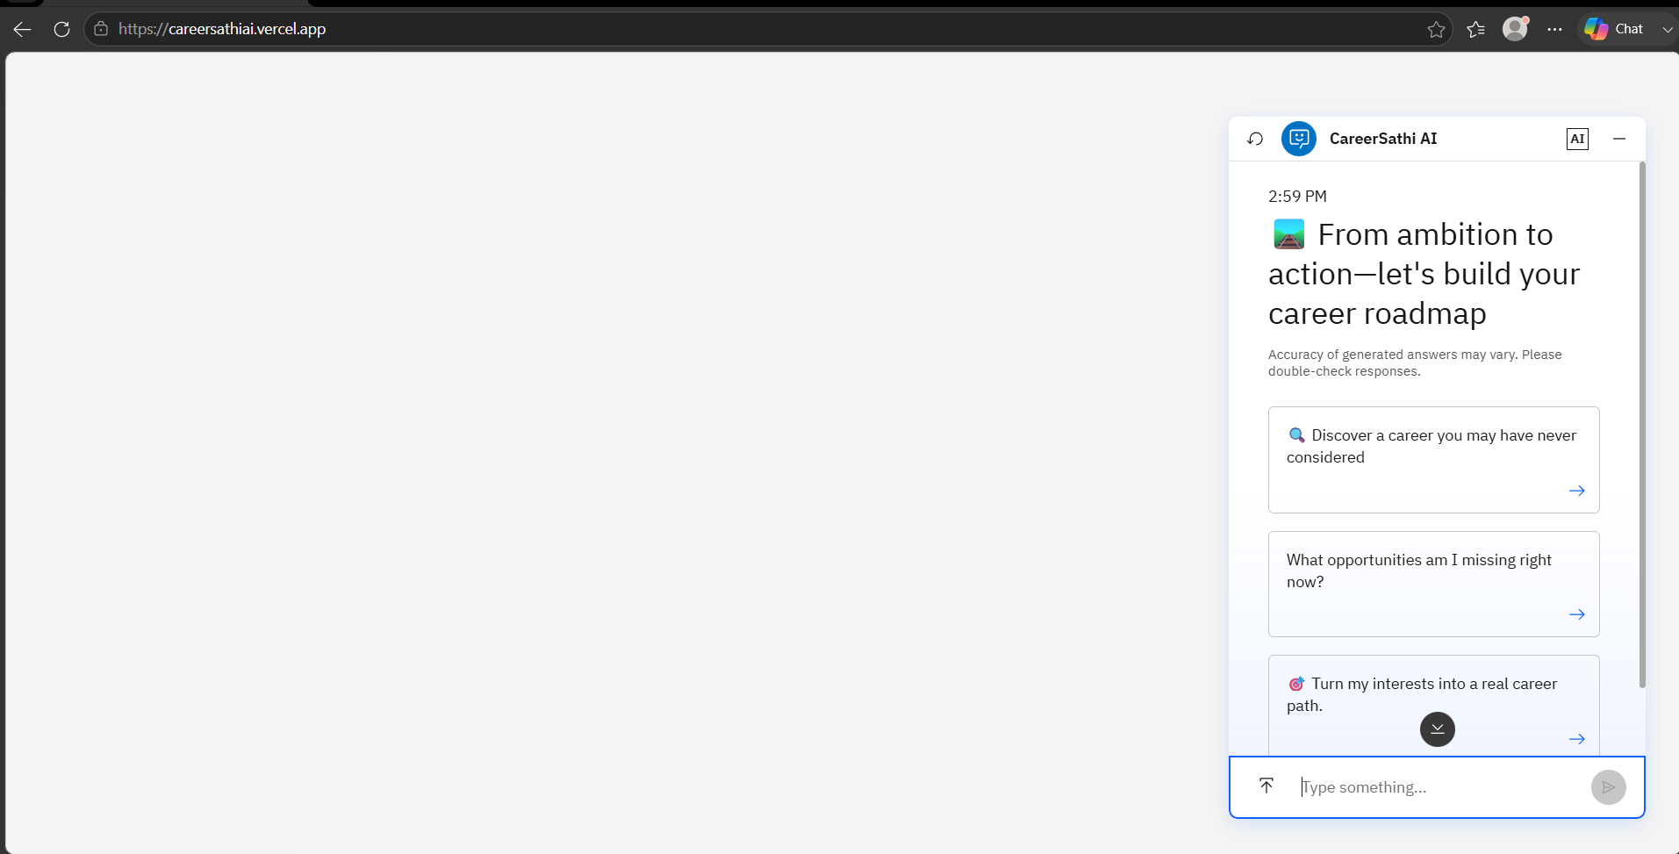
Using CareerSathi AI
Step 4: The CareerSathi AI chat window will open.
Step 5: Enter your career-related queries.
Step 6: Receive personalized career guidance, skill recommendations, learning roadmaps, and internship suggestions.

Slide 20
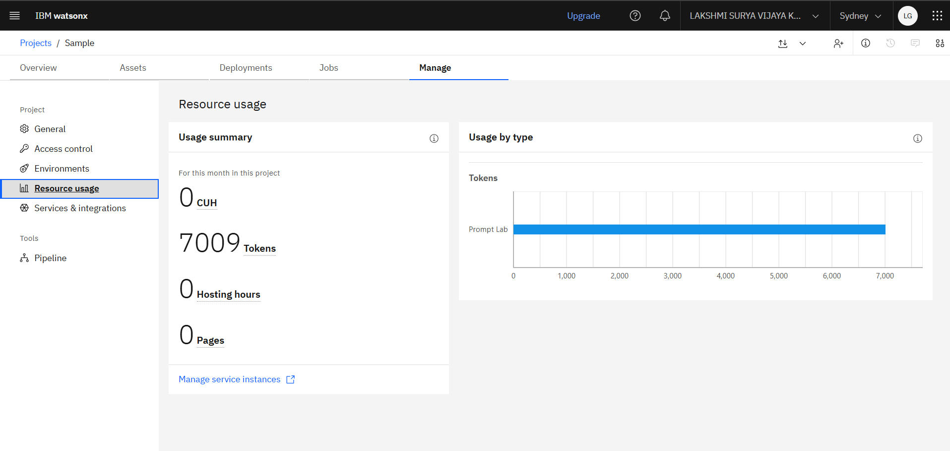
Token Usage

Slide 21
Future Scope
1. AI-Powered Voice Assistant & Multilingual Support
The system can be enhanced with voice interaction and support for regional languages, enabling rural students to access career guidance in their preferred language. This will improve accessibility and inclusiveness.
2. Advanced Career Prediction & Job Market Insights
Future versions can integrate real-time industry trends, job market analytics, and skill demand forecasting to provide more accurate career recommendations and emerging career opportunities.
3. Personalized Learning & Certification Tracking
CareerSathi AI can track student progress, recommend personalized courses and certifications, and dynamically update learning roadmaps based on individual achievements.
4. Scholarship & Internship Recommendation Engine
The platform can automatically identify and recommend relevant scholarships, internships, competitions, and higher education opportunities based on student profiles.
5. Mobile App & Offline Accessibility
A dedicated mobile application with offline support can help students in rural and low-connectivity regions access career guidance anytime and anywhere.
6. Institution & Placement Cell Integration
CareerSathi AI can be integrated with colleges and placement cells to provide institution-specific career guidance, placement preparation, and student progress monitoring.
·
·
·

Slide 22


